Slide 1

Big Mountain Resort Recommendation
Prepared by
Jonathan Laurizio

Slide 2
Problem Identification
Pricing model for ski resort tickets
Maximize returns
Optimal ticket prices
Important facilities

Slide 3
Recommendation
Optimal Ticket Price = $95.87
Additional Features:
Add run; add new chairlift; increase vertical drop by 150 ft
Optimal Ticket Price = $97.86
Changes must cost < $3,474,638

Slide 4
Modeling Results
Important features
Vertical Drop
Snow making area
Total number of chairs
Fast quads
# of runs
Skiable terrain area
Longest Run
Trams

Slide 5
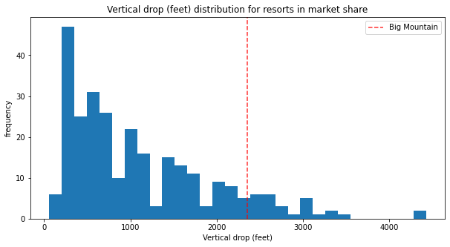
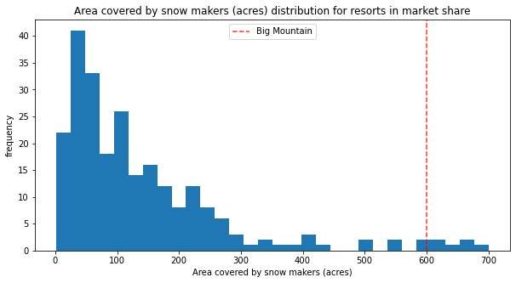
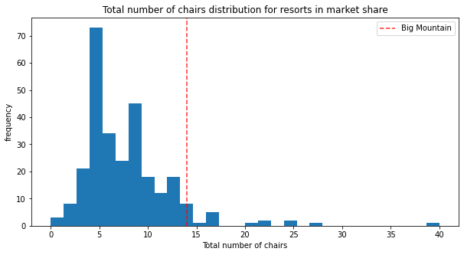
Modeling Results (continued)
Vertical drop is larger than most competitors
2353 ft
Has among the largest snow making area for resorts
600 acres
Higher echelon for total number of chairs (excluding outliers)
14 chairs

Slide 6
Modeling Results (continued)
Very few resorts with more fast quads
3 fast quads
More runs than most other resorts
105 runs
Most area of skiable terrain (excluding outliers)
3000 acres

Slide 7
Modeling Results (continued)
One of the longest runs among all resorts (excluding outliers)
3.3 miles
Same number of trams as most resorts
0 trams

Slide 8
Conclusion
Big Mountain Resort has better features than majority of all resorts
Current ticket price is too low ($81)
For current features, raise ticket prices to $95.87

